Slide 1
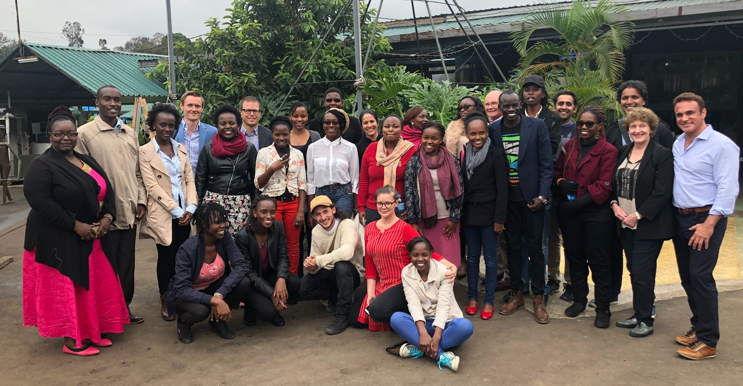
WPA & CitiesRise Achievement Overview February 2019
Nairobi, Kenya, June 2018

Slide 2
Core objectives of partnership
To ensure that psychiatry is community oriented and practiced within a framework of community care
To strengthen the networks of support and communications for psychiatrists engaged in community-based work and community development related to the improvement of mental health
To identify, collate and develop materials and resources that support the partnership work of citiesRISE and the WPA
To provide conceptual and technical support to the development of citiesRISE programs, ensuring that the promotion of mental health and wellbeing and access to care is supported by the best available evidence and experience

Slide 3
Snapshot of outputs: citiesRISE theory of Change
Global Community of Practice
Learn
Advocate
Innovate
Generation of insights for learning & advocacy
Drives the scale of supply-side interventions
Mental Health Friendly Cities
Mental health is valued
Healthy environment
Access to care, support, and treatment
Social connectedness
Proof of concept based on data, evidence and insights
Strategies for Accelerating Innovation
Drives strategic interventions & Innovations
Youth Mobilization
Creative Campaigns
Intersectoral Collaboration
Technology
Clinic to Community

Slide 4
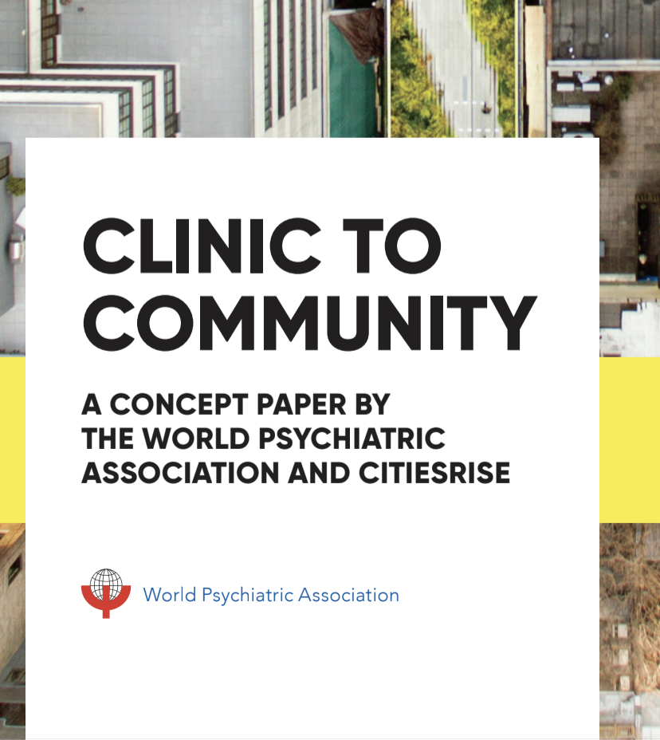
Snapshot of outputs: Clinic to Community
This includes collaborative work with communities to strengthen their capacity to:
Reduce the onset of mental health problems by promoting mental wellbeing, preventing mental health problems, and improving social connectedness
Improve psychosocial functionality of people suffering from mental ill-health through early intervention, treatment, and rehabilitation
Integrate support for mental health across sectors through education and training, awareness-raising, stigma reduction, policy reform, and cooperative partnerships to improve service delivery and psychosocial support systems.

Slide 5
Key activities In 2019
Operationalize community oriented practice as one of the core acceleration strategies for the city program design and its development pathways, with initial focus on Chennai/Nairobi/Bogota/Sacramento/Seattle
Set-up a Center of Excellence to serve as a central hub to scale practice transformation efforts in a city and region, with initial focus on Bangalore-Chennai and expansion to Nairobi/Bogota/Seattle
Research & Advocacy
Collaborative funding applications for at least four other mutually agreed initiatives that further the joint objectives of WPA and citiesRISE
Six publications on agreed topics that support practice transformation, including a clinic-to-community concept note and a literature review of practice transformation.
Joint advocacy promoting practice-transformation and the mutual goals of WPA and citiesRISE in key international forums including the World Health Organization and World Economic Forum.

Slide 6
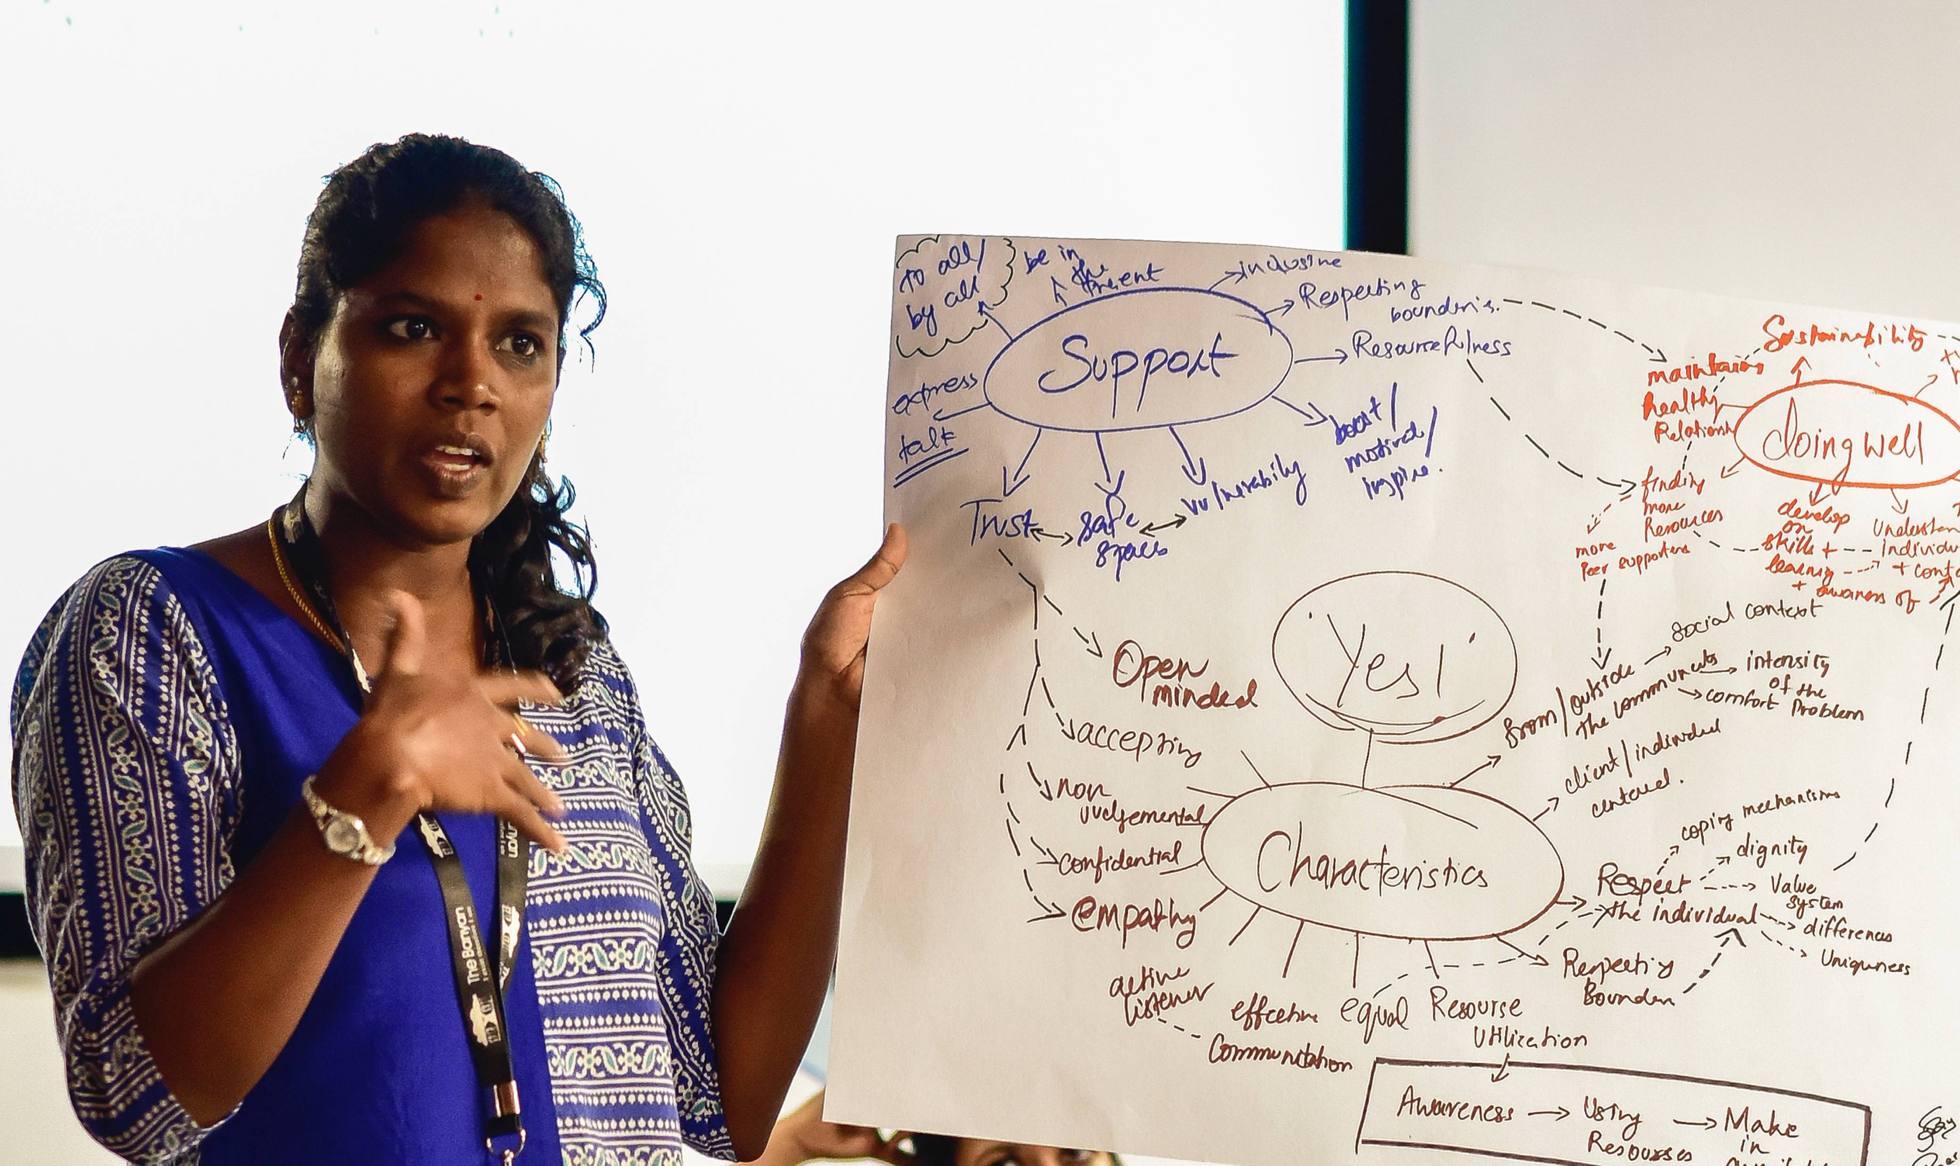
citiesRISE & WPA highlights
Picture 1: A young leader from Chennai articulates what peer support should be like which is forming the basis of new interventions through citiesRISE for youth
Picture 2: Youth perspectives on mental health needs, challenges, gaps shaping transformative efforts for system change at a workshop in Chennai

Slide 7
citiesRISE & WPA highlights
Innovative interventions through performing arts and theater (developed by young group Nzumari Africa to take the message on mental wellbeing to people in the sums of Nairobi) being linked to larger systems for scaling up in Kenya

Slide 8
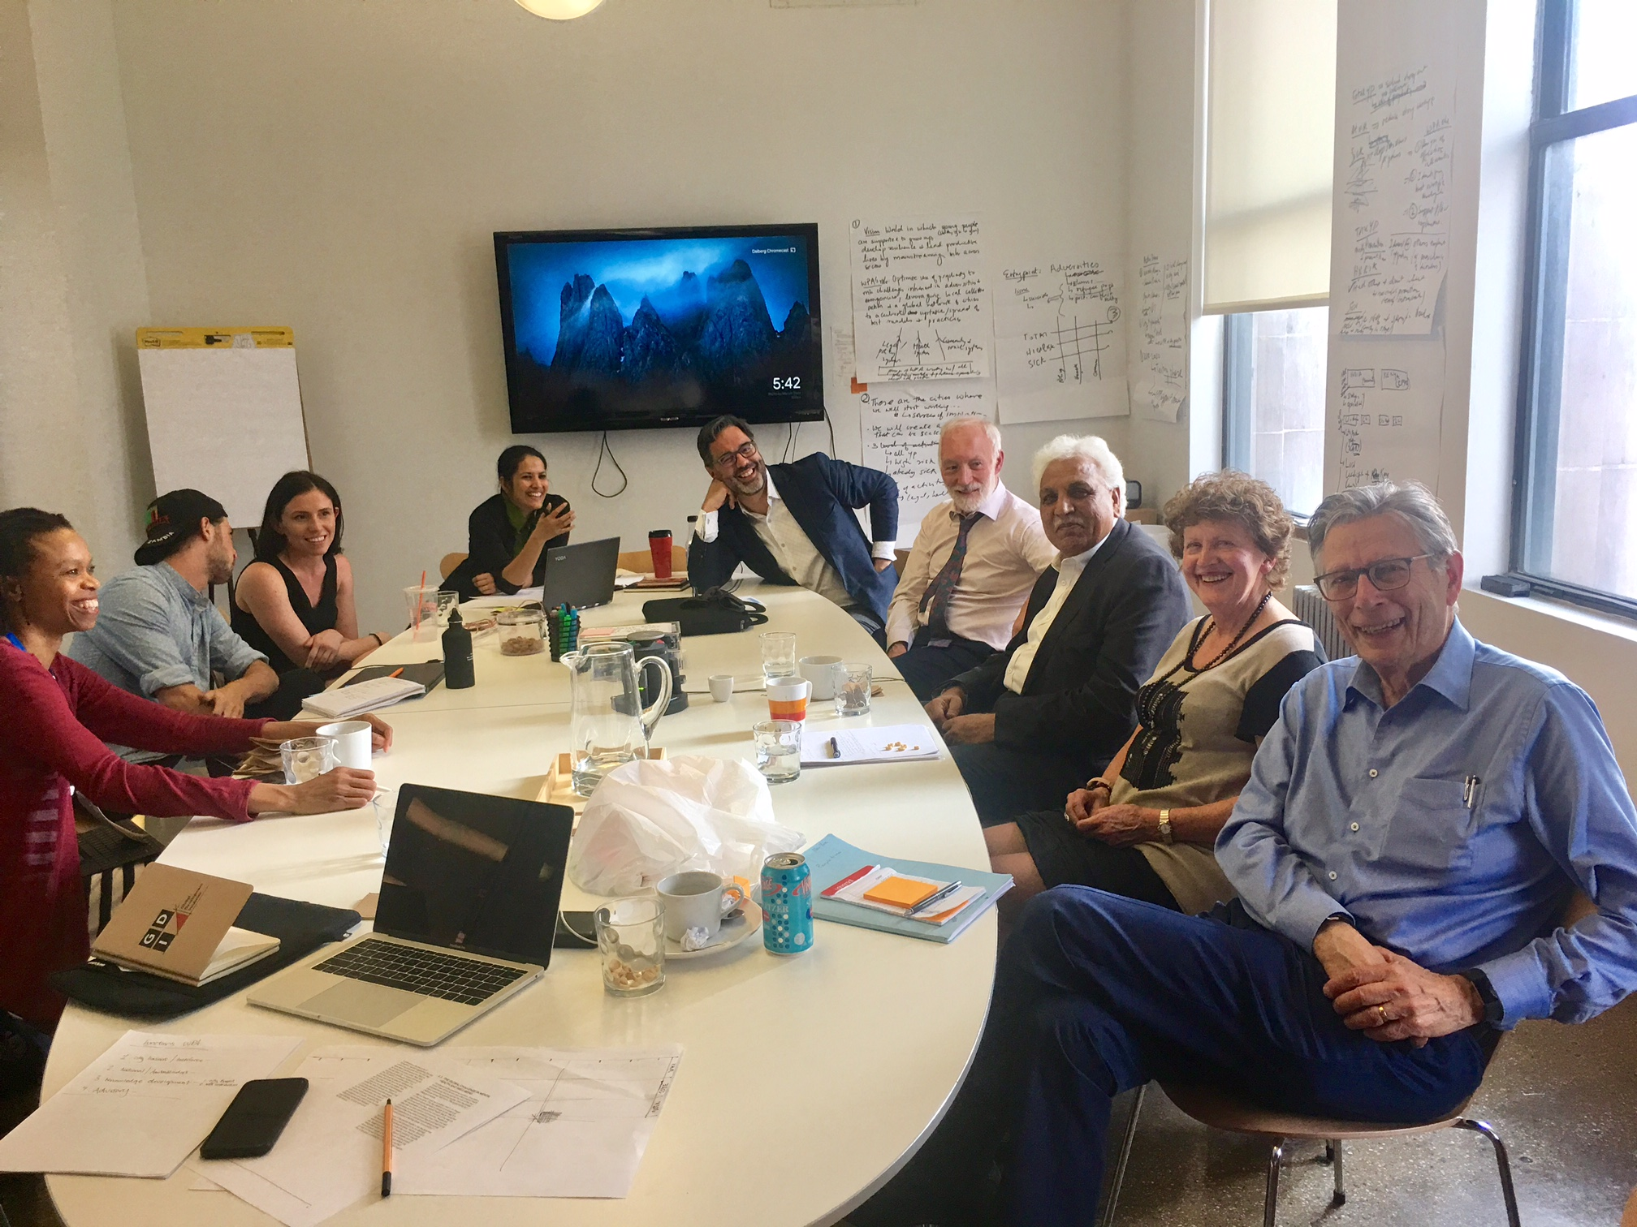
citiesRISE & WPA highlights
citiesRISE & WPA leadership in NYC discussing strategies for intervention design and local decision-making. May 2018

Slide 9
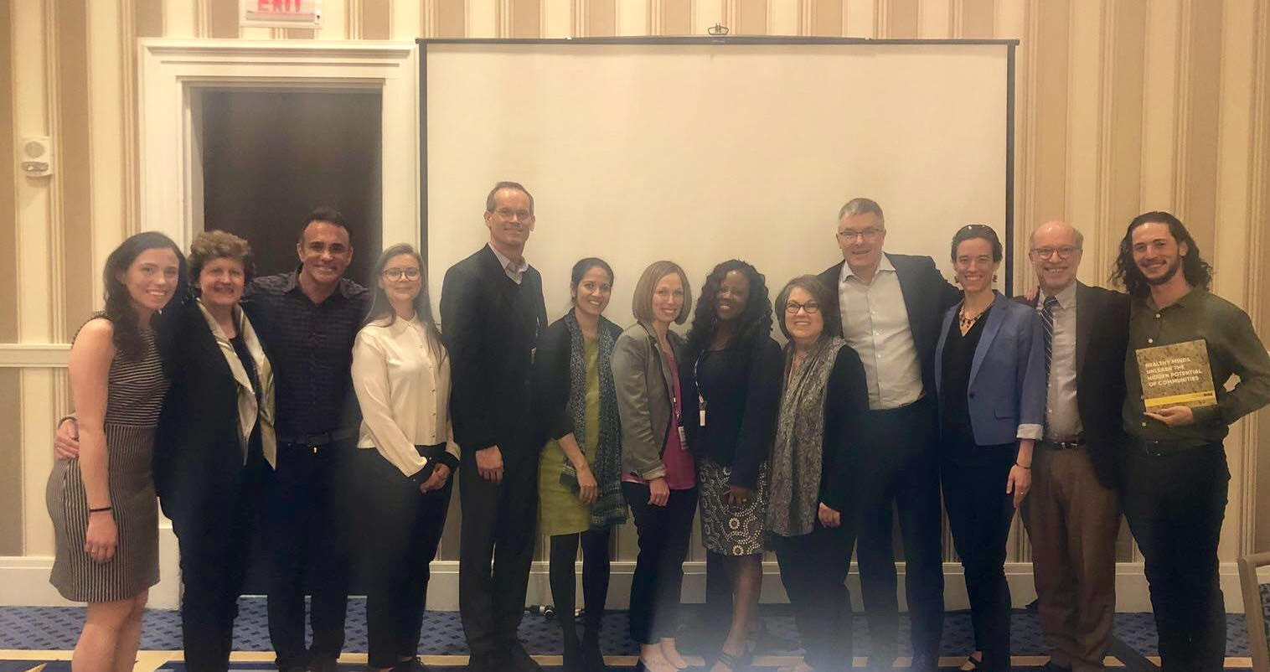
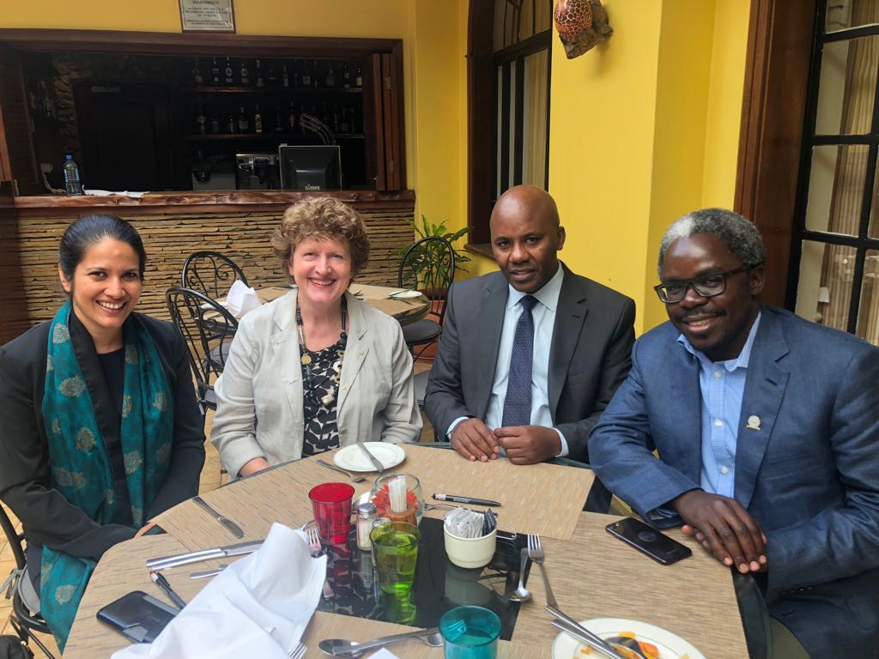
(2) citiesRISE & WPA highlights
Picture 5: citiesRISE & WPA hosting a convening in Washington DC of national level mental health funders in the United States
Picture 6: Signing into partnership with the Kenyan Ministry of Health and Kenyan Psychiatric Association

